Slide 1

Airbnb Hotel Booking Analysis (DIY Project)
S I VIGNESHWAR
APPLY_175570417568a5eb6f74ed1

Slide 2

PROBLEM STATEMENT
Airbnb has become one of the most popular platforms for short-term rentals around the world. Every day, thousands of listings are added and updated, creating a huge amount of data. But most of this data isn’t used effectively — hosts don’t always know how to price their properties, travellers struggle to find the best deals, and even researchers miss out on trends hidden in the data. The main problem is figuring out how to analyse this data properly to get meaningful insights that can actually help people make better decisions.

Slide 3
Project Description
This project is all about exploring and understanding Airbnb data through data analysis.
The goal is to take a large dataset of Airbnb listings and find out what factors affect prices, availability, ratings, and popularity of different properties.
I started by cleaning the dataset —
removing missing values,
fixing inconsistent data, and organizing it properly.
After that, I performed Exploratory Data Analysis (EDA) using Python libraries like Pandas,
NumPy,
Matplotlib, and Seaborn.

Slide 4
During the analysis, I looked at different aspects such as:
Which neighbourhoods have the highest number of listings and reviews
How room types (entire home, private room, etc.) affect pricing
What relationship exists between the number of reviews and the property’s popularity
How availability changes based on location or season
I then created different visualizations — like bar charts, scatter plots, and heatmaps — to make the patterns easier to understand.
In the end, I summarized the main findings and gave insights that could help both hosts and guests.
For example, hosts can see what makes listings more successful, and travellers can get an idea of where they can find good value stays.

Slide 5

WHO ARE THE END USERS?
Hosts and Property Owners
Travelers
Airbnb Management Team
Students and Data Enthusiasts

Slide 6

Technology Used
Python
Pandas (Library)
Matplotlib (Library)
Seaborn (Library)
Numpy (Library)
Jupyter Notebook

Slide 7
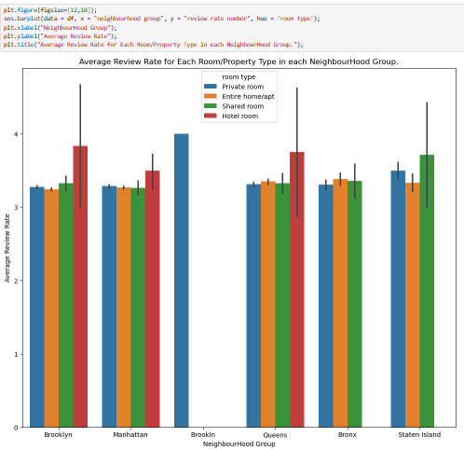
RESULTS1
[Add screen shots of your code or Chart(s) ]

Slide 8
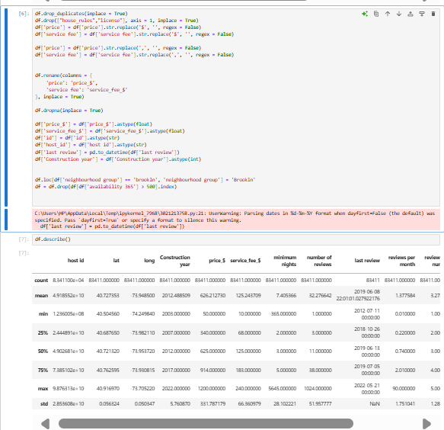
RESULTS2
[Add screen shots of your code or Chart(s) ]

Slide 9
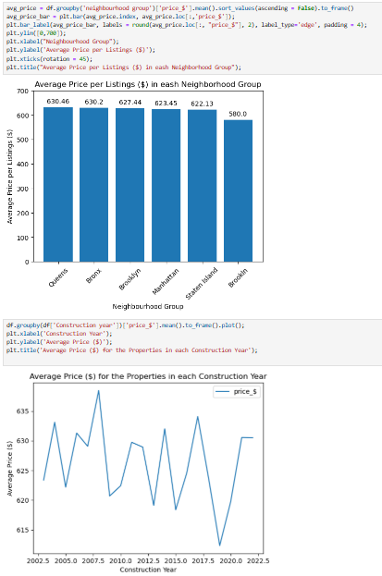
RESULTS3
[Add screen shots of your code or Chart(s) ]

Slide 10
GitHub repository
https://github.com/Ashrithvicky/VOIS_AICTE_Oct2025_DIYProject_AirBNB.git

Slide 11
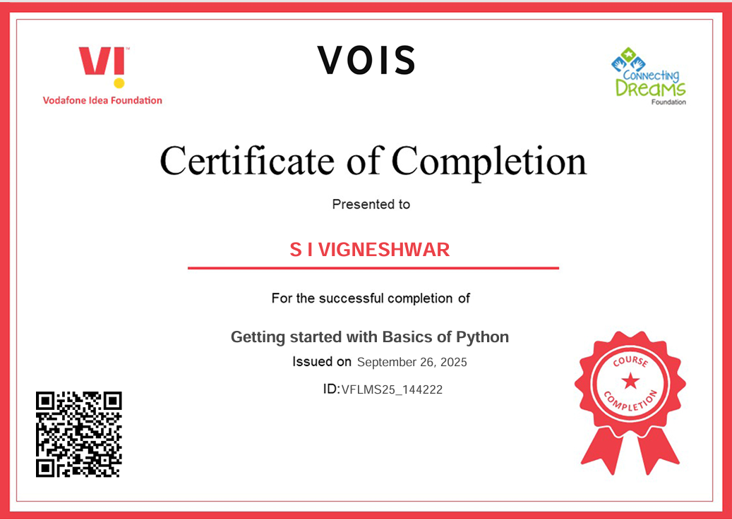
Getting started with Basics of Python Certificate
[Paste your Certificate Here]

Slide 12
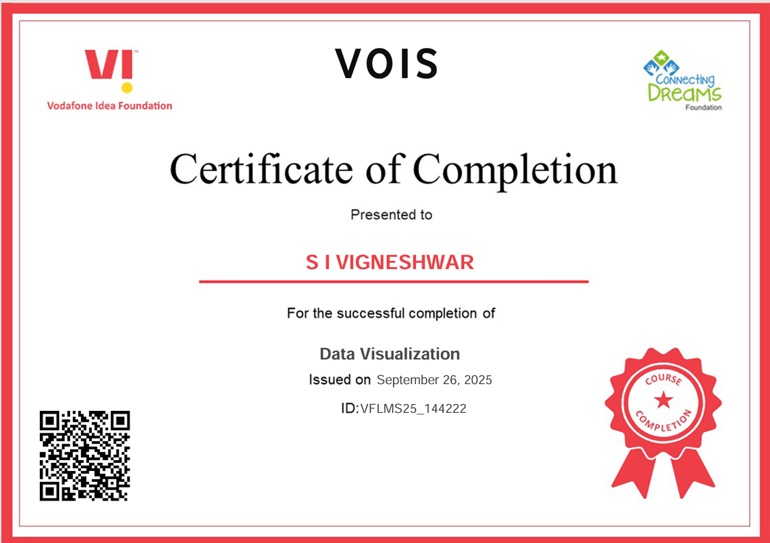
Data Visualization Certificate
[Paste your Certificate Here]

Slide 13
Thank you
.
.

